Slide 1
Forecasting the Price of LEGO Sets
Yu Cao

Slide 2
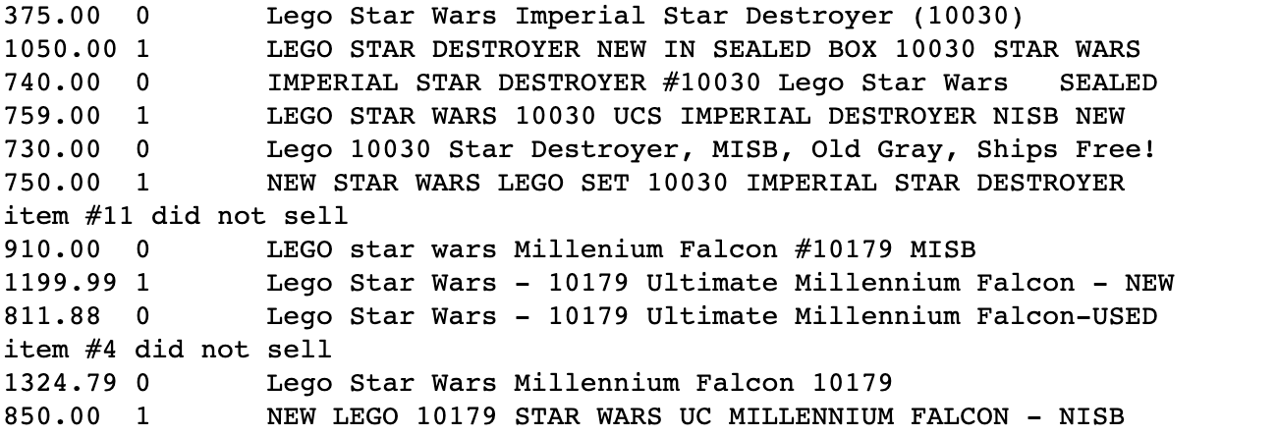
Collect
Extracted data from shopping website;
Got the features of these LEGO Sets, such as the number of pieces, listed price, new or old, etc…

Slide 3
Prepare and analyze
Extracted features and price data and got the matrix of features X and the matrix of their labels y;
Normalization
Inspected the data and fixed little problems.

Slide 4
Train
Standard regression function:
W = (X^{T}X)⁻¹X^{T}y
Ridge regression:
W = (X^{T}X + λI)⁻¹X^{T}y
Sometimes we might have a difficult time computing the inverse;
Regularization, add bias into our estimations;
Overfitting.

Slide 5
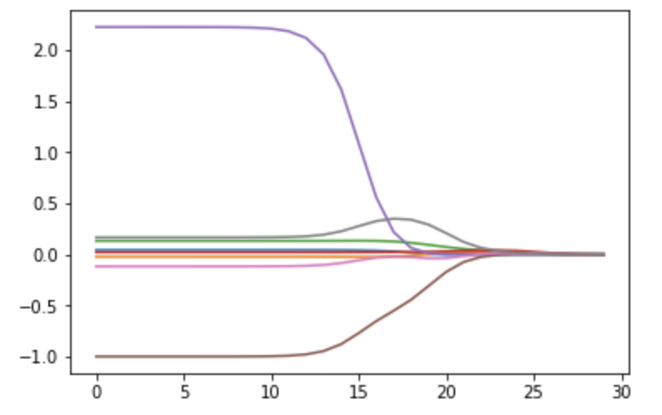
Train
Regression coefficient values while using ridge regression

Slide 6
Test
Bias and Variance
Cross-validation testing
We can see the regularized coefficients for different levels of shrinkage

Slide 7
Thank you!

